Slide 1
How to Lie with Plots
Notes:
I hope you already recognize that to be a responsible data scientist, you should strive to present an honest picture of what’s in your data.
It’s worth thinking about all the ways visualizations can present a distorted picture of data
Some of these may be overt and deliberate, and some may be accidental.
It takes vigilance and effort to lower the amount of distortion in your plots.

Slide 2
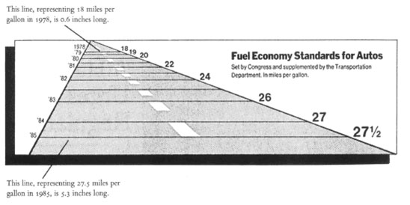
Notes:
Here’s a cautionary example of a plot, which appears in Tufte’s seminal book.
It originally appeared in the New York Times
This graph tries to show how fuel economy standards increase from year to year.
For example, at the top, in 1979, the federal standard was 18 mpg.
At the bottom, In 1985, it was 27.5 mpg.
Those numbers are correct, but the way they are graphically presented is distorting.
Take a moment to look at the graph, and see if you notice anything wrong.

Slide 3
Notes:
Please copy and use this slide each time you are pausing your lecture to ask students a question. Please delete this slide if you do not need to use it.

Slide 4
Notes:
You may have noticed that the lengths of the lines are not proportional to the quantities they represent.

Slide 5
Misrepresenting Fuel Economy

Slide 6
The Lie Factor
Notes:
Tufte introduces the idea of the lie factor to measure how distorting a graph is
Remember: If you draw a line on your plot, readers expect its magnitude to be meaningful
They may also expect its slope to be meaningful

Slide 7
Notes:
There is more to notice about this graph
The 3D perspective tricks our eyes, making it seem like the top line is further away. Is it actually the same length, just the width of the road? That would suggest no change in fuel economy.
The road, and the offset border further distracts our eyes
Tufte has a name for extra stuff like this that distracts from the data – chart junk.

Slide 8
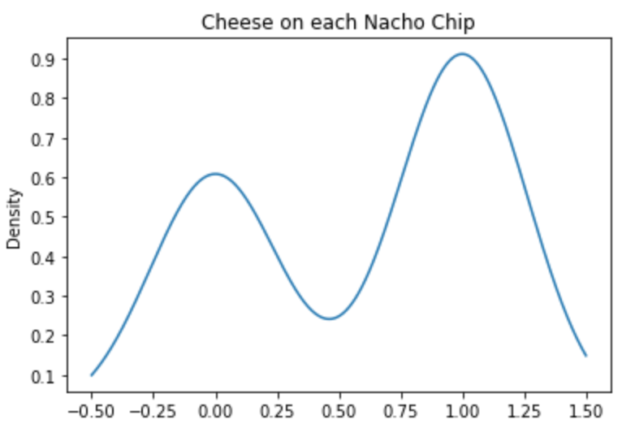
Notes:
Let’s move to some less dramatic, but more immediately useful examples.
Here’s an example of a kernel-density plot.
You see this and get excited about the bimodal distribution.
Perhaps you even start wondering about the slope of the curve. The author put the line there, so the slope must mean something…
In fact, this is a true story: past students have turned in graphs almost exactly like this on statistics labs.
When I see one, I start to wonder what the raw data looks like.

Slide 9
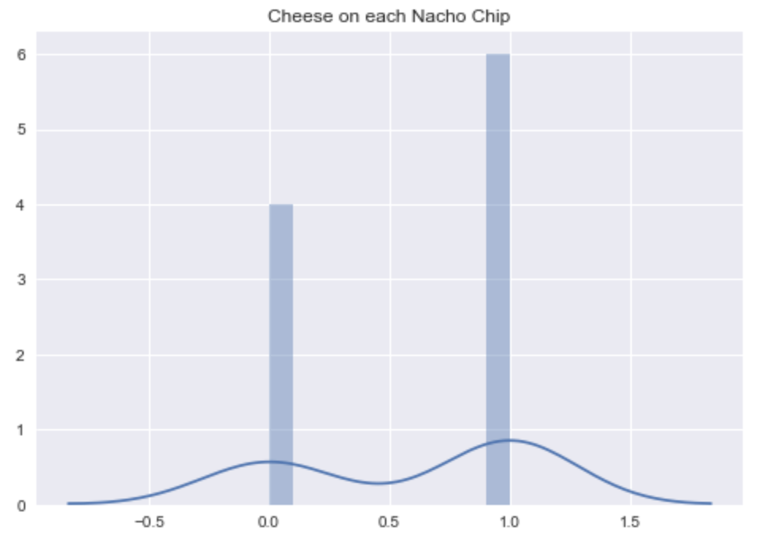
Notes:
In fact, the histogram reveals that the only values are zero and one!
The kernel density plot smooths out these peaks (that’s the job of the kernel function).
In this case, that totally distorts the underlying data!
You think the slope of the curve is meaningful, but it’s just an artifact of the kernel function.
I think there’s another lesson to be had here: As Tufte says, “Above all else show the data”
Remember that the data is most important.
The kernel density smoother is really a simple model for the data.
Sometimes you want to plot both the data and the model you fit to the data.
But you still need the data… or some way to assess how well the model fits the data.

Slide 10
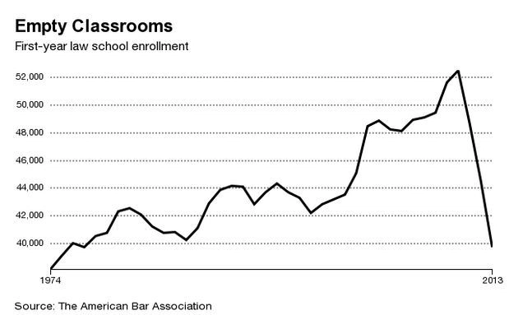
Notes:
Something else to think about: How do you set the y-axis range?
Here’s a graphic about the number of students going into law schools. If you just take a quick glance at it, it looks like the number of new students plummeted in 2013.
The y-axis doesn’t start from zero, which makes slopes look a lot more dramatic.
Our eyes tend to notice the distance from the line to the bottom axis.
I’m not saying that you have to start your y-axis at zero in 100% of cases
But you should consider whether zero is really the most relevant baseline for comparison.
In cases like this, the resulting graph may look flat – but that’s the point. The data is telling you there isn’t much change.
Here the title is “Empty Classrooms,” which makes it especially relevant to compare against zero.

Slide 11
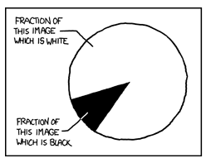
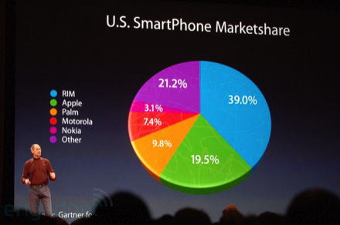
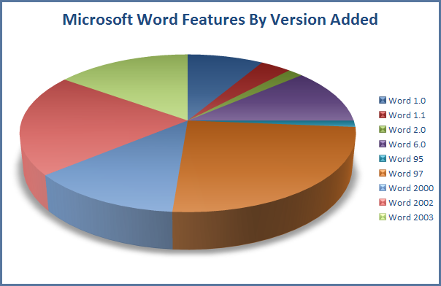
Pie Charts
Notes:
Some types of distortion result from limits of our visual system
While we’re on that topic, we should mention pie charts.
Pie charts are everywhere, appearing in powerpoint presentations around the world – even immortalized in xkcd cartoons.
They are so ubiquitous that students often use them without asking whether they are the best tool.

Slide 12
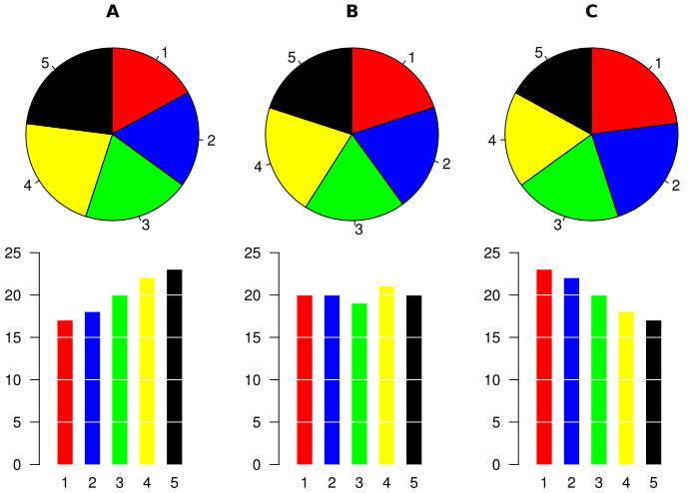
Notes:
Unfortunately, researchers have shown that humans are just not good at interpreting pie charts.
Our eyes are not adept at comparing slices of a circle.
In this example, you can see how much easier it is to see small differences in a bar chart.
Because of effects like this, pie charts should almost always be avoided in rigorous data analysis.
If at all possible, try a bar chart or some other plot.

